Slide 1


PIR Motion Activated LED
Arduino with C Programming
ELECTRICAL ENGINEERING AND COMPUTER SCIENCE, COLLEGE OF ENGINEERING AND PHYSICAL SCIENCES
Notes:
Updated 27 Jun 2024 by Noah Mulvaney

Slide 2
Goals
Use a Passive Infrared (PIR) Sensor to make a motion activated Sensor
Calibrate the PIR Sensor’s sensitivity and range to more accurately detect motion
Use the PIR Sensor to light up a Light-Emitting Diode (LED) when there is motion detected

Slide 3
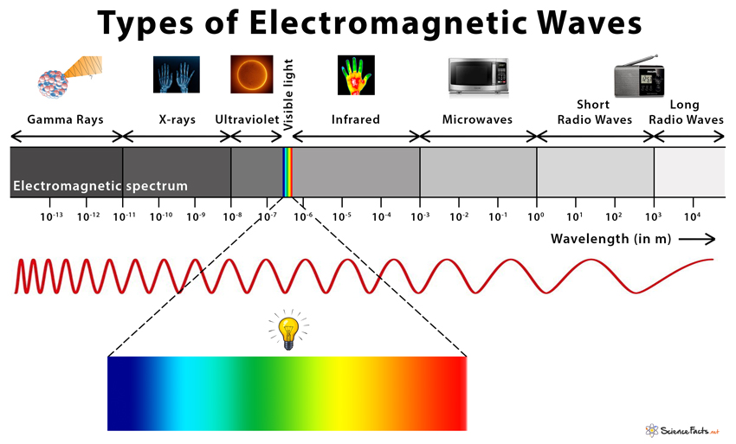
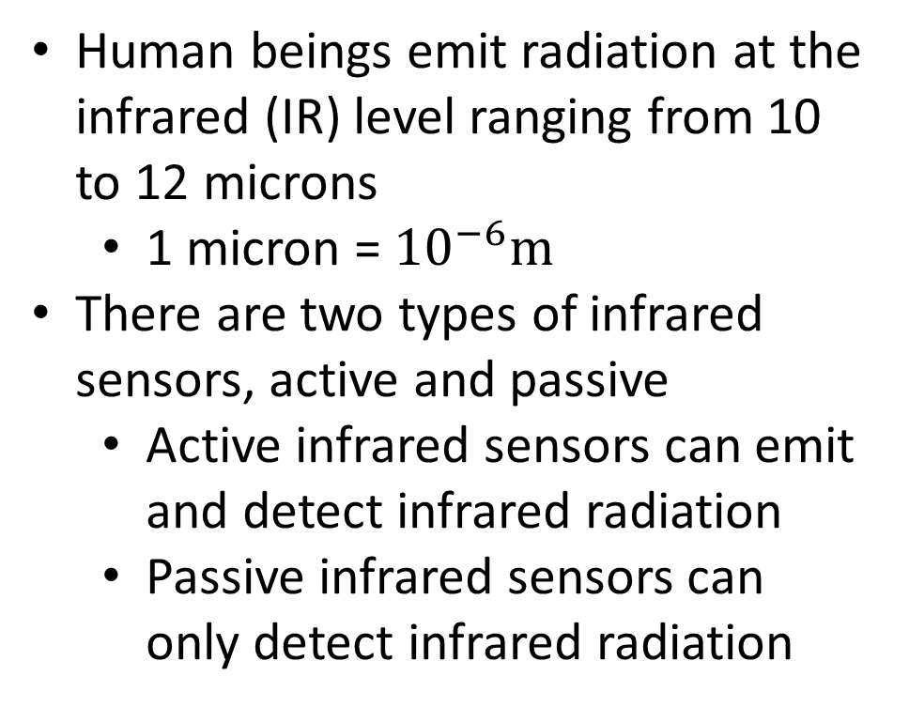
Introduction to Electromagnetic Waves and Infrared Sensors
Human beings emit radiation at the infrared (IR) level ranging from 10 to 12 microns
  1 micron = ${10}^{−6}m$
There are two types of infrared sensors, active and passive
  Active infrared sensors can emit and detect infrared radiation
  Passive infrared sensors can only detect infrared radiation

Slide 4
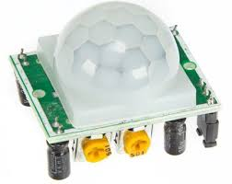
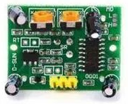
What is a Passive Infrared Sensor?
An electronic sensor that can detect and measure infrared radiation in its surrounding environment.
Where PIR sensors are used:
  In-home security
  Automatic lighting
  Public Transportation
  Industrial safety
Notes:
Public transportation – Seeing when people show up and how many show up to better optimize routes and times.
Industrial safety – Detecting if there is a human presence in an area that there should not be (around machines, Sewage treatment plants, or on large boats)

Slide 5
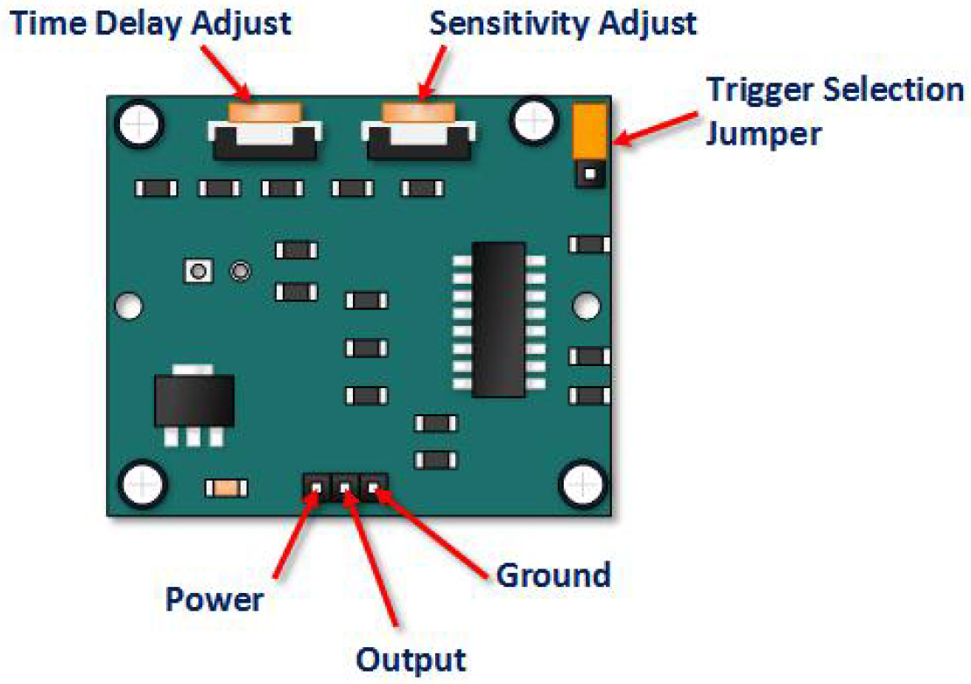
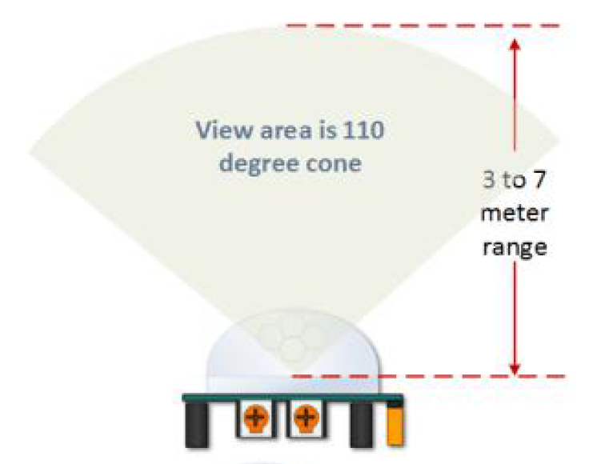
Components of the PIR Sensor
Device requires about a minute to initialize after the sensor is energized
Power pin requires +5V DC
Output pin goes high on detected motion, otherwise stays low

Slide 6
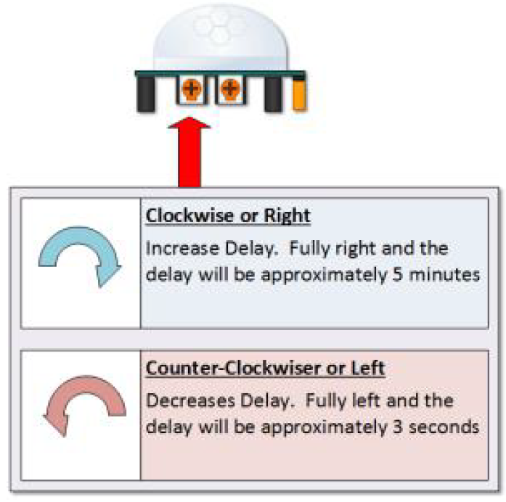
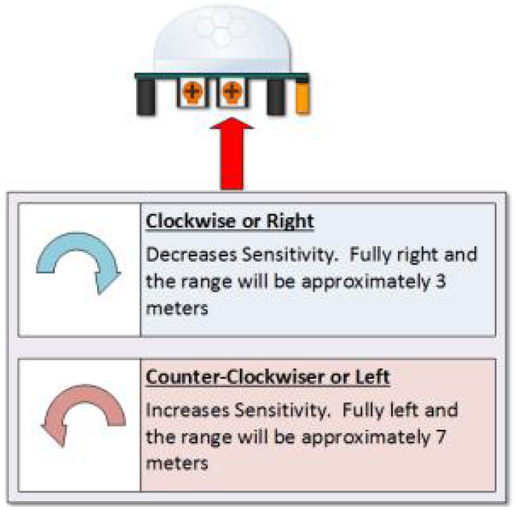
How to Adjust the PIR Sensor’s Sensitivity
Time Delay
Adjustment
Sensitivity
Adjustment

Slide 7
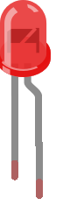
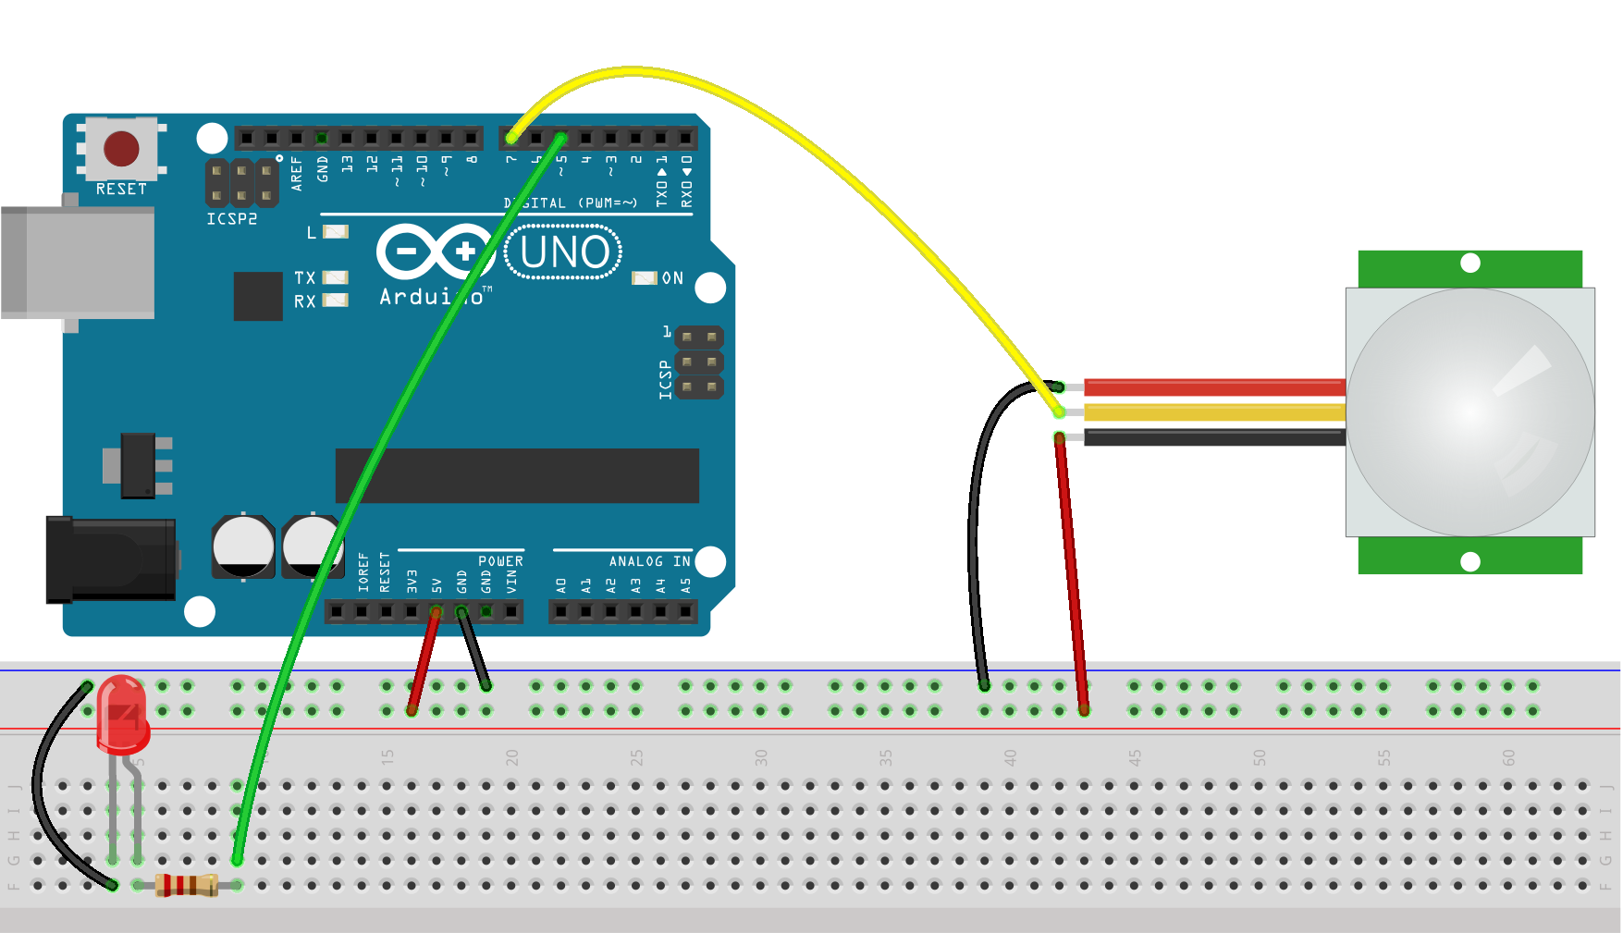
Circuit Diagram
Pin 7
*Make sure that the wires are connected in the right spot on the PIR Sensor
Pin 5
Short (-)
Long (+)
5V
GND
220 Ω

Slide 8
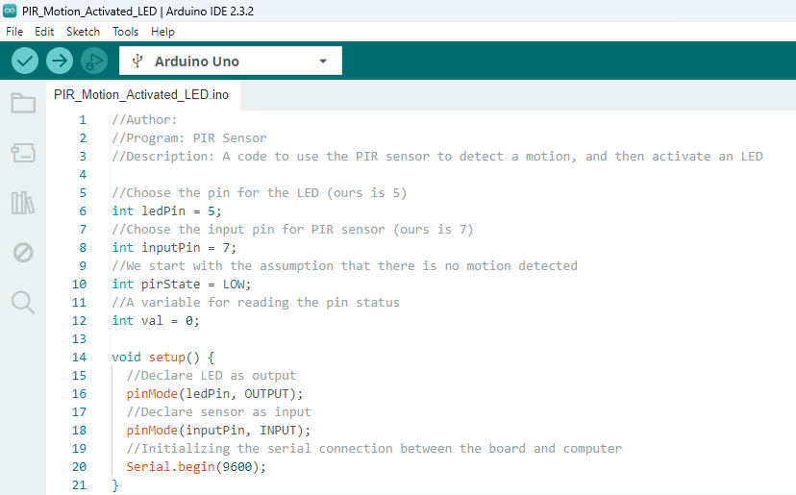

Coding

Slide 9
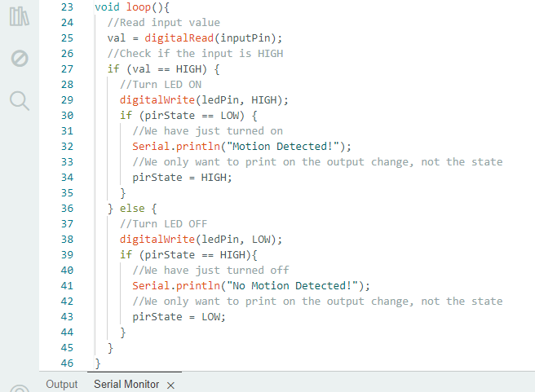

Coding

Slide 10
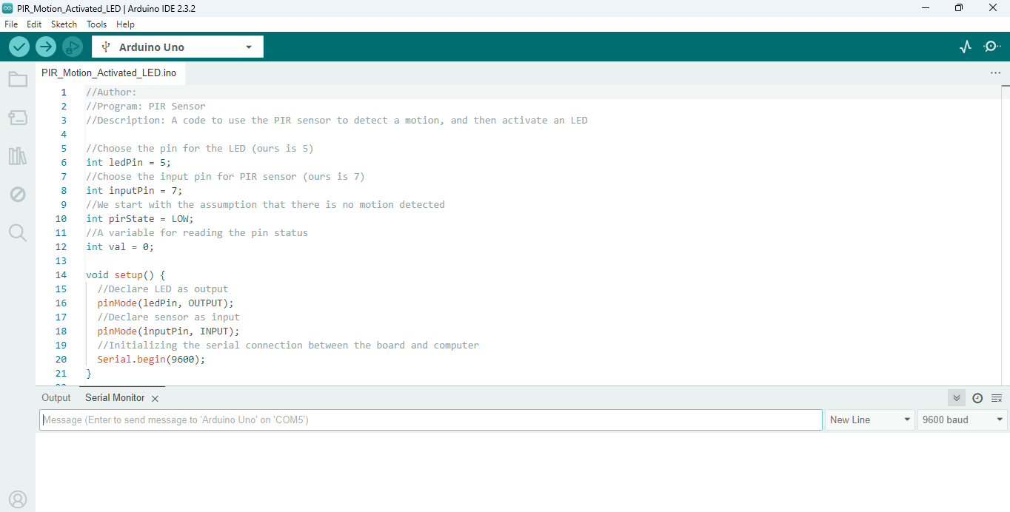
Test it Out!
Run the program
  Click upload to send the code to the Arduino
  Click the serial monitor to see the text being displayed when the PIR Sensor detects movement
Upload
Serial Monitor
Text Display

Slide 11
How to Adjust the PIR Sensor’s Sensitivity
Time Delay
Adjustment
Sensitivity
Adjustment

